Slide 1
Entity Relationship (E-R) Modeling

Slide 2
In this chapter, you will learn:
What a conceptual model is and what its purpose is
The difference between internal and external models
How internal and external models serve the database design process
How relationships between entities are defined and refined, and how such relationships are incorporated into the database design process
How ERD components affect database design and implementation

Slide 3
Basic Modeling Concepts
Art and science
Good judgment coupled with powerful design tools
Models
“Description or analogy used to visualize something that cannot be directly observed” Webster’s Dictionary

Slide 4
Basic Modeling Concepts
Data Model
Relatively simple representation of complex real-world data structures
Basic tools for database design
Communication
Good database design starts with a good design of data model.

Slide 5
Data Models: Degrees of Data Abstraction
Three different models (according to the degree of abstract)
Conceptual model
Global view of data
Basis for identification and description of main data items
Logical model
Representation of database as seen by DBMS
Adapts conceptual model to specific DBMS
Physical model
Lowest level of abstraction
Describe the ways data being stored

Slide 6
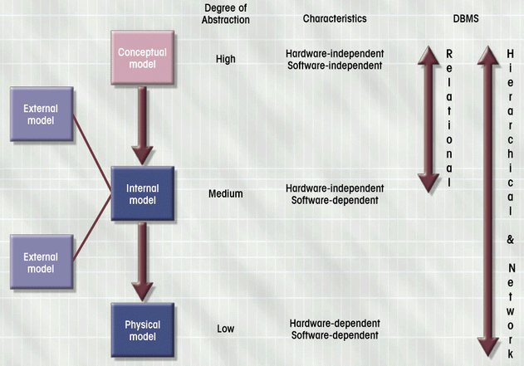
Logical Model

Slide 7
The Entity Relationship (E-R) Model
Represents conceptual view
Main Components
Entities
Corresponds to entire table, not row
Represented by rectangle
Attributes
Relationships

Slide 8
What Should an Entity Be?
SHOULD BE:
An object that will have many instances in the database
An object that will be composed of multiple attributes
An object that we are trying to model
SHOULD NOT BE:
A user of the database system
An output of the database system (e.g. a report)

Slide 9
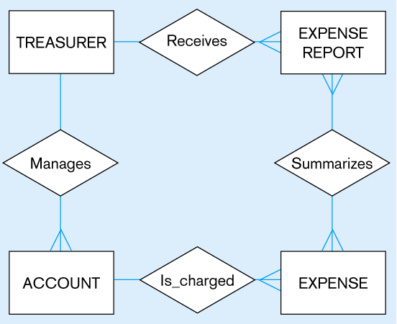
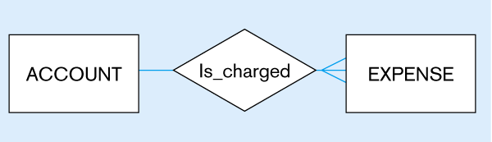
Figure 3-4
Inappropriate entities
System user
System output
Appropriate entities

Slide 10
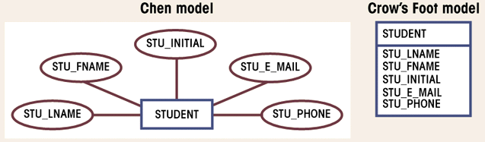
Attributes
Characteristics of entities
Domain is set of possible values
Primary keys underlined
Figure 3.6

Slide 11
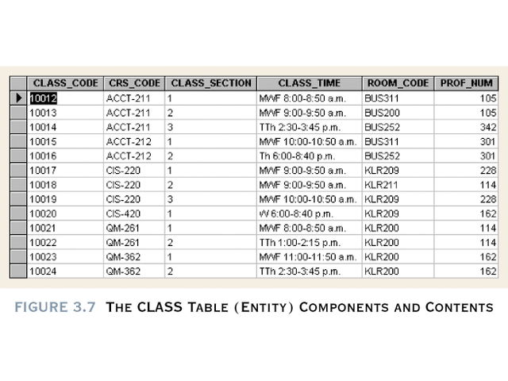

Slide 12
Simple
Cannot be subdivided
Age, sex, marital status
Composite (avoided)
Can be subdivided into additional attributes
Address into street, city, zip
Single-valued
Can have only a single value
Person has one social security number
Multi-valued (avoid) in RDBMS
Can have many values
Person may have several college degrees
How to avoid? (see next slide)
Derived
Can be derived with algorithm (Age can be derived from date of birth)
Need to be stored

Slide 13
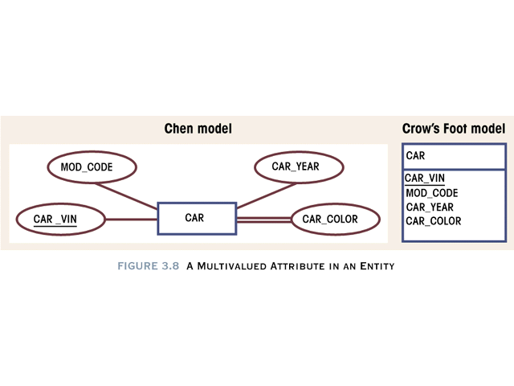

Slide 14
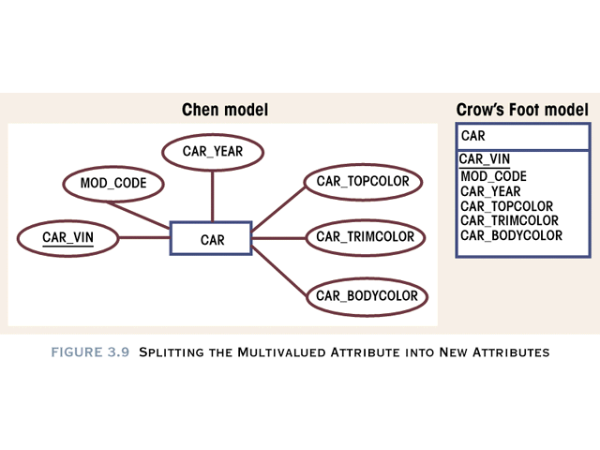

Slide 15
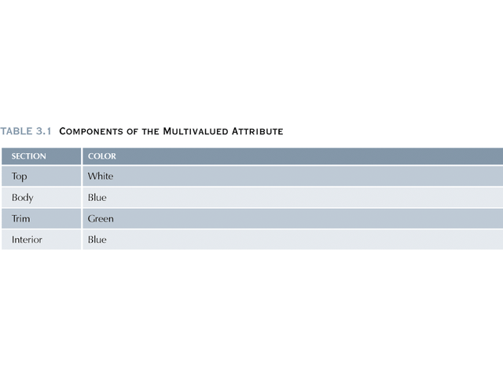

Slide 16
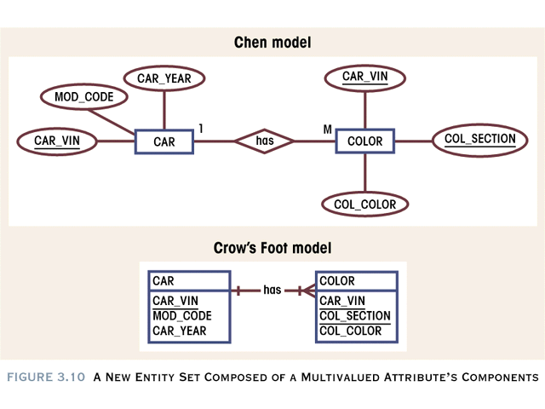

Slide 17
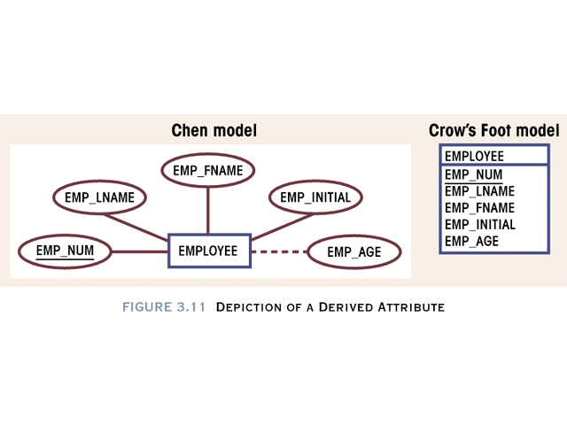

Slide 18
Relationships
Association between entities
Connected entities are called participants
Operate in both directions
Connectivity describes relationship classification
1:1, 1:M, M:N
Cardinality
Expresses number of entity occurrences associated with one occurrence of related entity

Slide 19
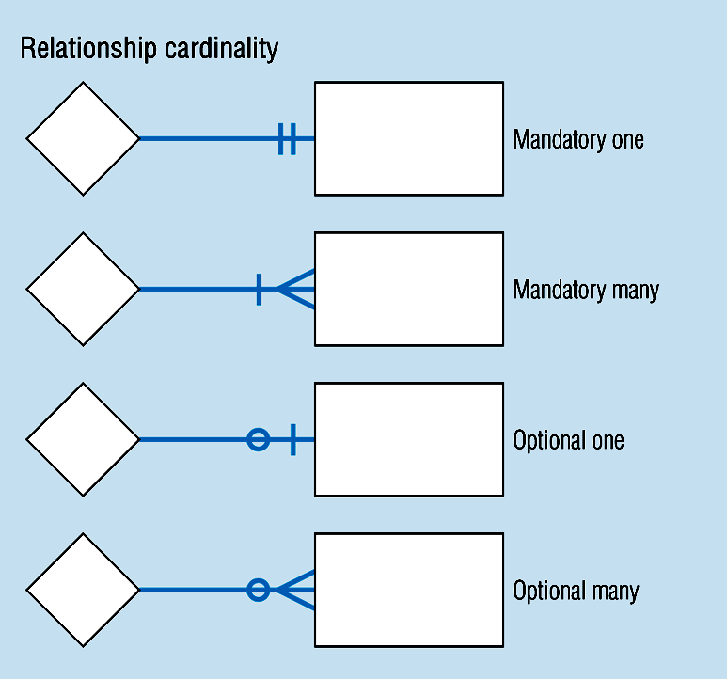
Relationship Participation

Slide 20
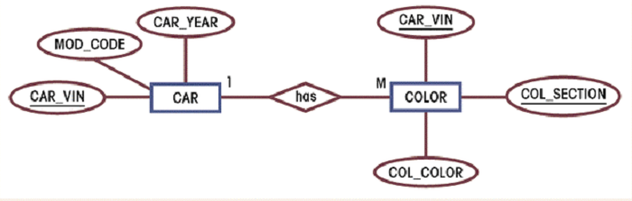
Relationship Strength
Existence dependence
Entity’s existence depends on existence of related entities
Existence-independent entities can exist apart from related entities
Example:

Slide 21
Relationship Strength
Weak (non-identifying)
Strong (identifying)

Slide 22
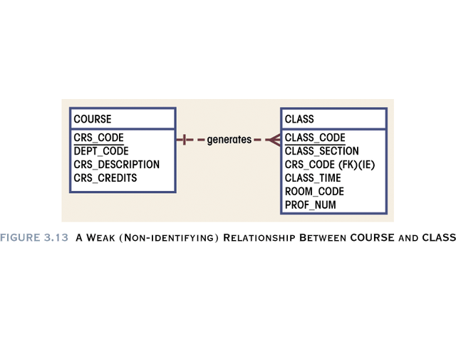

Slide 23
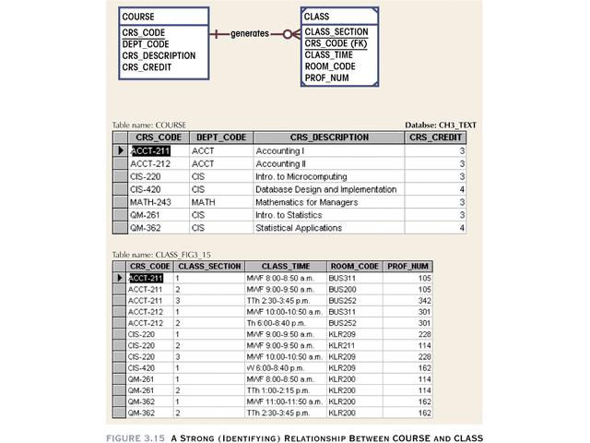

Slide 24
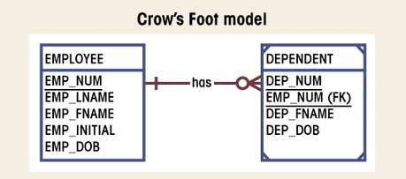
Weak Entity
Existence-dependent on another entity
Has primary key that is partially or totally
derived from parent entity
Figure 3.19

Slide 25
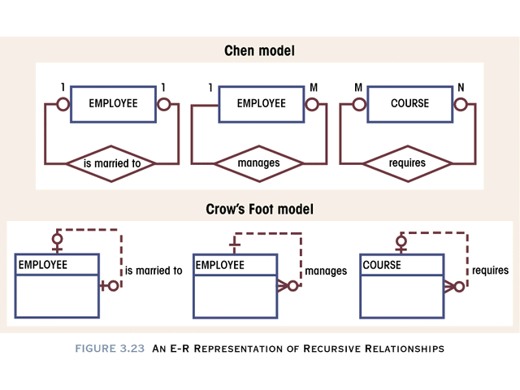

Slide 26
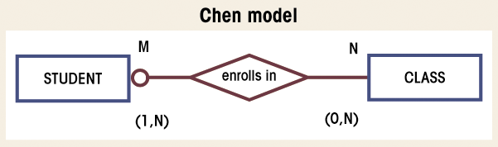
Composite Entities
Used to ‘bridge’ between M:N relationships
Bridge entities composed of primary keys of each entity needing connection
Figure 3.30

Slide 27
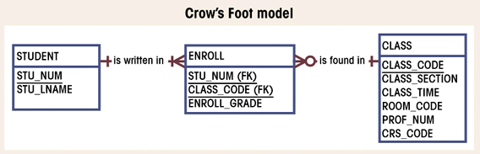
Composite Entities (con’t.)
Figure 3.31

Slide 28
Developing an E-R Diagram (With some repetition)

Slide 29
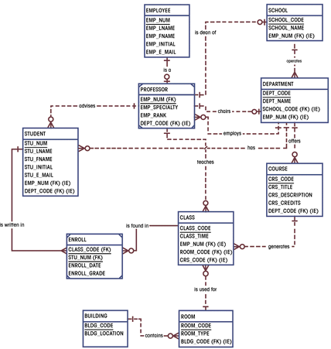
Completed ERD
Figure 3.52

Slide 30
Introduction
Entity Relationship Modeling (ERM)
a technique used to analyze & model the data in organizations using an Entity Relationship (E-R) diagram.
Notes:
2
2

Slide 31
Why use ER Diagrams ?
provides a global quick reference to an organization’s data structures.
can be used individually to design an Information System’s (IS) data structure
can be used with Data Flow Diagrams to provide a more comprehensive IS logical design.
Notes:
4
4

Slide 32
ERD Development Process
Identify the entities
Determine the attributes for each entity
Select the primary key for each entity
Establish the relationships between the entities
Draw an entity model
Test the relationships and the keys
Notes:
5
5

Slide 33
A Simple Example
STUDENTs attend DEGREEs that consist of many COURSESs.
A single COURSE (i.e. English) can be studied in many different DEGREE.
Each STUDENT may only attend one DEGREE.
Notes:
6
6

Slide 34
Identify the entities
Any entity can be classified in one of the following categories:
Regular :
any physical object, event, or abstract concept that we can record facts about.
Weak :
any entity that depends on another entity for its existence.
Notes:
7
7

Slide 35
Determine the Attributes
Every Entity has attributes.
Attributes are characteristics that allow us to classify/describe an entity
e.g., entity STUDENT has the attributes:
student number
name
date of birth
course number
Notes:
8
8

Slide 36
Key Attributes
Certain attributes identify particular facts within an entity, these are known as KEY attributes.
The different types of KEY attribute are:
Primary Key
Composite Primary Key
Foreign Key
Notes:
9
9

Slide 37
Key Definitions
Primary Key:
One attribute whose value can uniquely identify a complete record (one row of data) within an entity. Irreducible
Composite Primary Key
A primary key that consists of two or more attribute within an entity. Irreducible
Foreign Key
A copy of a primary key that exists in another entity for the purpose of forming a relationship between the entities involved.
Notes:
10
10

Slide 38
ER Diagram Components
Every entity diagram consists of the following components:
Course
Entity (labelled box)
Relationship line
Notes:
11
11

Slide 39
Degrees of a Relationship
One-to-one (1:1)
1
1
Stud
Woman
One-to-many (1:n)
1
M
Order
Customer
Many-to-many (n:m)
M
M
Course
Subject
NOTE: Every many to many relationship consists of two one to
many relationships working in opposite directions
Notes:
12
12

Slide 40
Degrees of relationship, alternative representation
One-to-one (1:1)
Man
Woman
One-to-many (1:n)
Customer
Order
Many-to-many (n:m)
Course
Subject
NOTE: Every many to many relationship consists of two one to
many relationships working in opposite directions

Slide 41
A Sample ER Diagram
Student
Course
Subject
A Student Record Entity Diagram
Notes:
13
13

Slide 42
Library Case Study
When a library first receives a book from a publisher it is sent, together with the accompanying delivery note, to the library desk. Here the delivery note is checked against a file of books ordered.
If no order can be found to match the note, a letter of enquiry is sent to the publishers. If a matching order is found, a catalogue note is prepared from the details on the validated delivery note.
The catalogue note, together with the book, is sent to the registration department. The validated delivery note is sent to the accounts department where it is stored.
On receipt of an invoice from the publisher, the accounts department checks its store of delivery notes. If the corresponding delivery note is found then an instruction to pay the publishers is made, and subsequently a cheque is sent. If no corresponding delivery note is found, the invoice is stored in a pending file.

Slide 43
Summary
In today’s session we have learned to:
Identify the entities
Determine the attributes for each entity
Select the primary key for each entity
Establish the relationships between the entities
Draw an entity model
Notes:
23
23

Slide 44
A Case Study
Conference centre booking system
A conference centre takes bookings from clients who wish to hold courses or conferences at the
centre. When clients make bookings they specify how many people are included in the booking,
and of these, how many will be resident during the booking, and how many will require catered or
non-catered accommodation at the centre.
The centre contains a number of facilities which may be required by clients making bookings as
follows:
A. There are 400 bedrooms for clients who will be resident during the Course or
conference.
B. A maximum of 250 catered people can be handled at any one time.
C. Six main lecture theatres providing seating for 200 people.
D. Twenty seminar rooms each able to accommodate 25 people.
E. Video conference facilities. The video conference facilities consist of four separate
video conference networks. Each video conference network has a large screen based
in one of the main lecture theatres, along with 3 satellite screens each of which is
based in one of the seminar rooms.
Draw an entity relationship diagram for the case, stating any assumptions you deem necessary.
Notes:
11
14

Slide 45
Shipping company example
The London and Ireland Shipping Company PLC (LISC) was founded in 1852 and owns a fleet of cargo ships. The company had historically run passenger liners, but recent policy decisions involved the sale of all passenger-carrying vessels. The company currently has 14 vessels, including one oil tanker and one tugboat operating out of Liverpool. Most of the vessels are registered in Liberia for tax reasons.
Each ship has one or more holds divided into spaces. The holds are defined by steel bulkheads and the spaces are defined by shelf racks or other physical dividers. Sister ships, built by the same shipbuilders and to the same designs have similar names, such as Pride of Ireland, Queen of Ireland, Song of Ireland and Warrior of Ireland. Sister ships also have identical cargo storage facilities.
LISC issues contracts to agents for one or more manifests (lists of cargo items to be shipped). LISC's charges for cargo carried are based on the number of spaces the cargo requires for storage. The types of cargo typically carried by LISC include grain, coal and ores (carried only in ships equipped with bulk cargo holds). They also transport sacked grain, heavy cases, containers (which may be carried on deck), pallets and so on.
Cargo items may take up less than one space in a hold, or one or more spaces, depending on the size of the item. A space may therefore contain several small cargo items.
The ships owned by LISC are kept as busy and as full as possible, in order to maximise the profits that each vessel makes and minimise running & operating costs. LISC's ships ply most of the seas of the world, but tend to operate mainly in the Mediterranean, the North and Mid Atlantic and the Indian Ocean. Different ships require different crew complements.
LISC intends to create a computer based information system that will be able to perform the following tasks:
• record the voyages of each ship with the start and end ports.
• record the cargo held by a ship on each voyage
• keep records of their employees and the ships they are assigned to
• producing invoices for agents and customers
• keep a record of customers' payments on invoices
• analyse the efficiency of use of cargo space and of percentage wasted cargo space for ships voyages

